Slide 1

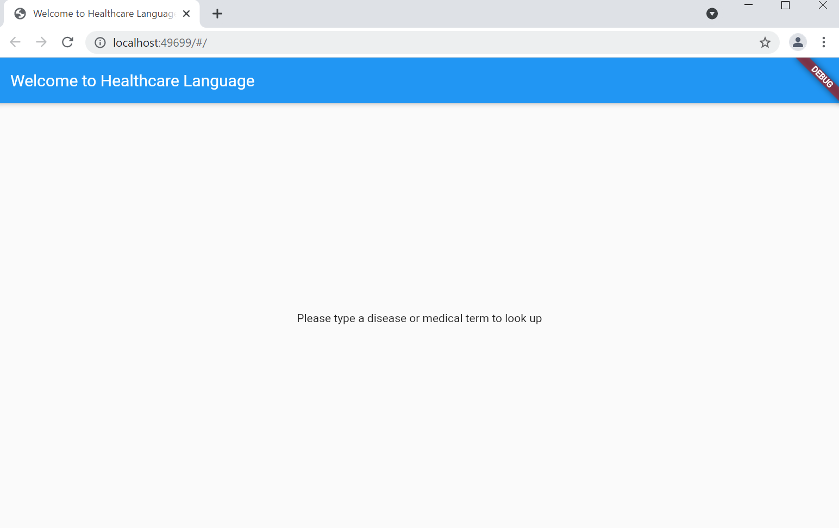
HEALTHCARE LANGUAGE APP
Michelle Padelford and Lee Solomon
A Flutter application providing users easy access to easily understandable medical terminology and definitions
Please type a medical term:
https://github.com/ksu-hmi/Healthcare-Language
Suitable for iOS or Android users

